Slide 1
Different approaches
Brute-Force Approach
Heuristic Search
Two-Player-Games Search
Interleaving Search

Slide 2
Heuristic Search
Heuristic search is an AI search technique that employs heuristic for its moves.
Heuristic is a rule of thumb that probably leads to a solution.
Heuristics play a major role in search strategies because of exponential nature of the most problems.
Heuristics help to reduce the number of alternatives from an exponential number to a polynomial number.
In a general sense, the term heuristic is used for any advice that is often effective, but is not guaranteed to work in every case.
Within the heuristic search architecture, however, the term heuristic usually refers to the special case of a heuristic evaluation function.

Slide 3
Heuristic Search (cont…)
Heuristic Information
In order to solve larger problems, domain-specific knowledge must be added to improve search efficiency. Information about the problem include the nature of states, cost of transforming from one state to another, and characteristics of the goals.
This information can often be expressed in the form of heuristic evaluation function, say f(n,g), a function of the nodes n and/or the goals g.

Slide 4
Heuristic Search (cont…)
Heuristic search techniques.
Pure Heuristic Search
Hill Climbing
A* algorithm
Iterative-Deepening A*
Depth-First Branch-And-Bound
Heuristic Path Algorithm
Recursive Best-First Search

Slide 5
Informed Search
Add domain-specific information to select the best path along which to continue searching
Define a heuristic function, h(n), that estimates the “goodness” of a node n.
Specifically, h(n) = estimated cost (or distance) of minimal cost path from n to a goal state.
The heuristic function is an estimate, based on domain-specific information that is computable from the current state description, of how close we are to a goal

Slide 6
Pure Heuristic Search (cont,,,)
In a graph with cycles, multiple paths will be found to the same node, and the first path found may not be the shortest.
  When a shorter path is found to an open node, the shorter path is saved and the longer one is discarded.
  When a shorter path to a closed node is found, the node is invaded to open and the shorter path is associated with it.
  The main drawback of pure heuristic search is that since it ignores the cost of the path so far to node n, it does not find optimal solutions.

Slide 7
Pure Heuristic Search : Best first Search
BFS, UCS and pure heuristic search are all special cases of a more general algorithm called best-first search.
In each cycle of a best-first search,
  The node that is best according to some cost function is chosen for expansion.
  These best-first search algorithms differ only in their cost functions the depth of node n for breadth-first search,
    g(n) for uniform-cost search
    h(n) for pure heuristic search.

Slide 8
Best First Search
A combination of depth first and breadth first searches.
DFS allows a solution to be found without all competing branches having to be expanded and BFS does not get branches on dead end paths.
The best first search combines the two and follows a single path at a time, but switch paths whenever some competing path looks more promising than the current one does.
If one of the nodes chosen generates nodes that are less promising it is possible to choose another at the same level and in effect the search changes from depth to breadth.
The tree is stored and
  At any stage if there are no nodes better then the previously unexpanded node, the process reverts to the descendants of the first choice and proceeds
  backtracking as it were.

Slide 9
Best First Search Algorithm:
Start with OPEN holding the initial state
Pick the best node on OPEN
Generate its successors
For each successor Do
  If it has not been generated before evaluate it add it to OPEN and record its parent
  If it has been generated before change the parent if this new path is better and in that case update the cost of getting to any successor nodes
If a goal is found or no more nodes left in OPEN, quit, else return to 2.

Slide 10
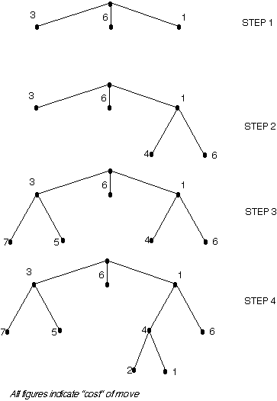

Slide 11
OR-graph
It is sometimes important to search graphs so that duplicate paths will not be pursued.
An algorithm to do this will operate by searching a directed graph in which each node represents a point in problem space.
Each node will contain:
  Description of problem state it represents
  Indication of how promising it is
  Parent link that points back to the best node from which it came
  List of nodes that were generated from it
Parent link will make it possible to recover the path to the goal once the goal is found.
The list of successors will make it possible, if a better path is found to an already existing node, to propagate the improvement down to its successors.
This is called OR-graph, since each of its branches represents an alternative problem solving path

Slide 12
Implementation of OR graphs
We need two lists of nodes:
  OPEN – nodes that have been generated and have had the heuristic function applied to them but which have not yet been examined. OPEN is actually a priority queue in which the elements with the highest priority are those with the most promising value of the heuristic function.
  CLOSED- nodes that have already been examined. We need to keep these nodes in memory if we want to search a graph rather than a tree, since whenver a new node is generated, we need to check whether it has been generated before.

Slide 13
BFS
Step 1
A

Slide 14
BFS
Step 1
Step 2
A
A
B
C
5
D
1
3

Slide 15
BFS
Step 1
Step 2
Step 3
A
A
A
B
C
5
D
1
B
C
D
3
3
5
1
E
4
F
6
1

Slide 16
BFS
Step 1
Step 2
Step 3
A
A
A
B
C
5
D
1
B
C
D
3
3
5
1
Step 4
E
4
F
A
6
B
C
5
D
1
3
G
H
E
4
F
6
5
6

Slide 17
BFS
Step 1
Step 2
Step 3
A
A
A
B
C
5
D
1
B
C
D
3
3
5
1
Step 4
Step 5
E
4
F
A
A
6
B
C
D
B
C
5
D
1
3
5
1
3
E
F
G
H
E
4
F
G
6
H
5
4
6
5
6
6
A
2
A
1

Slide 18
Pure Heuristic Search
Simple Generate and Test method with evaluation function
expands nodes in order of their heuristic values h(n).
It maintains a closed list of those nodes that have already been expanded, and a open list of those nodes that have been generated but not yet been expanded.
The algorithm begins with just the initial state on the open list.
  At each cycle, a node on the open list with the minimum h(n) value is expanded, generating all of its children and is placed on the closed list.
  The heuristic function is applied to the children, and they are placed on the open list in order of their heuristic values.
  The algorithm continues until a goal state is chosen for expansion.

Slide 19
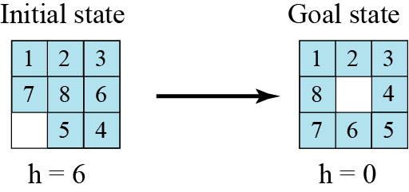
Heuristic Calculation
Using heuristic search, we assign a quantitative value called a heuristic value (h value) to each node. This quantitative value shows the relative closeness of the node to the goal state.
Eg. Problem to solve the 8-puzzle
Heuristic : The number of misplaced tiles (not including the blank)
Notation: h(n) Where h(current state) = 1

Slide 20
Heuristic Calculation (cont…)
Heuristic : The Manhattan Distance (not including the blank)
In this case, only the “3”, “8” and “1” tiles are misplaced, by 2, 3, and 3 squares respectively, so the heuristic function evaluates to 8.
3
2
8
1
2
3
Current State
Goal State
4
5
6
4
5
6
7
1
7
8
3
3
8
1
8
1
2 spaces
2 spaces
2 spaces

Slide 21
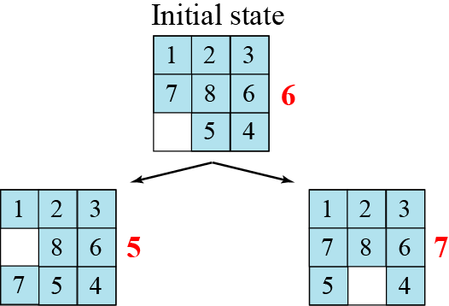
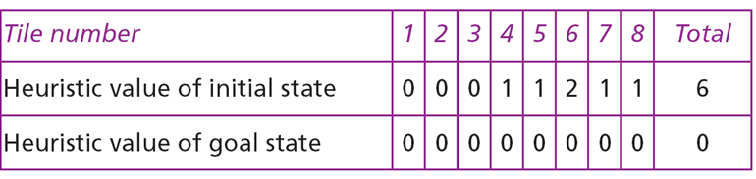
Complete solution for the 8 Puzzle problem

Slide 22
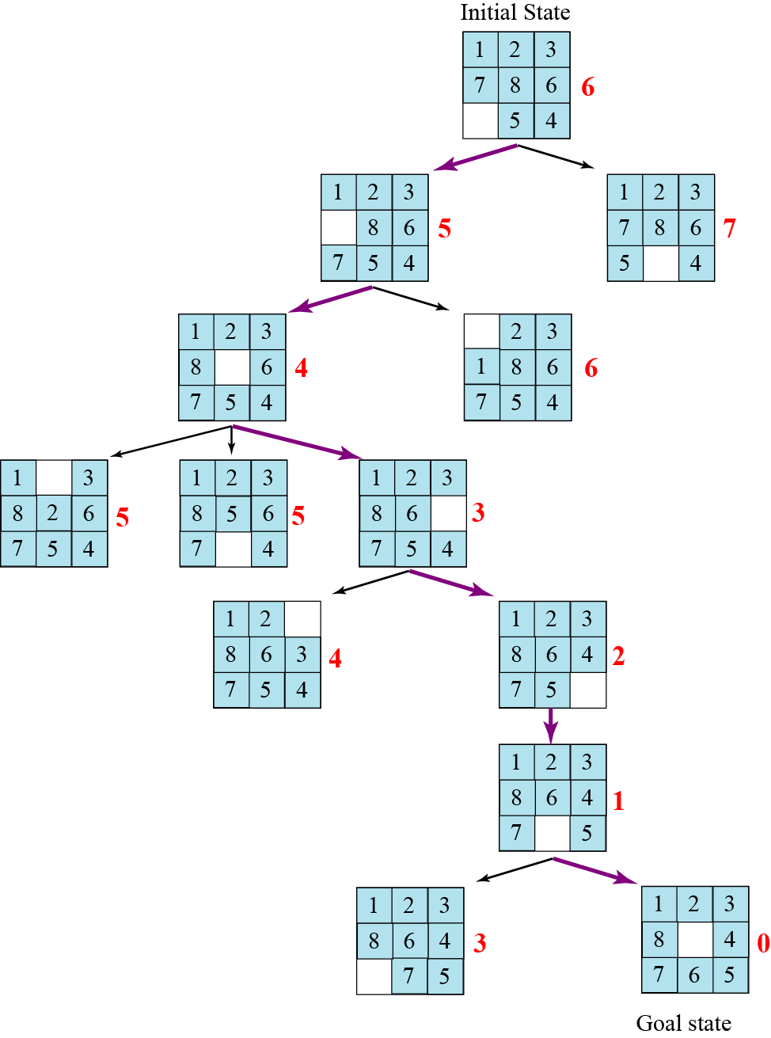
Heuristic search tree for solving the 8-puzzle

Slide 23
Hill Climbing
Is a variant of generate-and test in which feedback from the test procedure is used to help the generator decide which direction to move in search space.
The test function is augmented with a heuristic function that provides an estimate of how close a given state is to the goal state.
Computation of heuristic function can be done with negligible amount of computation.
Hill climbing is often used when a good heuristic function is available for evaluating states but when no other useful knowledge is available.

Slide 24
Simple Hill Climbing
Algorithm:
Evaluate the initial state. If it is also goal state, then return it and quit. Otherwise continue with the initial state as the current state.
Loop until a solution is found or until there are no new operators left to be applied in the current state:
  Select an operator that has not yet been applied to the current state and apply it to produce a new state
  Evaluate the new state
    If it is the goal state, then return it and quit.
    If it is not a goal state but it is better than the current state, then make it the current state.
    If it is not better than the current state, then continue in the loop.

Slide 25
Simple Hill Climbing
The key difference between Simple Hill climbing and Generate-and-test is the use of evaluation function as a way to inject task specific knowledge into the control process.
Is on state better than another ? For this algorithm to work, precise definition of better must be provided.

Slide 26
Hill climbing example (1)
2
8
3
1
2
3
start
1
6
4
h = -4
goal
8
4
h = 0
7
5
7
6
5
-5
-5
-2
2
8
3
1
2
3
1
4
h = -3
8
4
h = -1
7
6
5
7
6
5
-3
-4
2
3
2
3
1
8
4
1
8
4
h = -2
7
6
5
7
6
5
h = -3
-4
Heuristic : f(n) = -(number of tiles out of place)

Slide 27
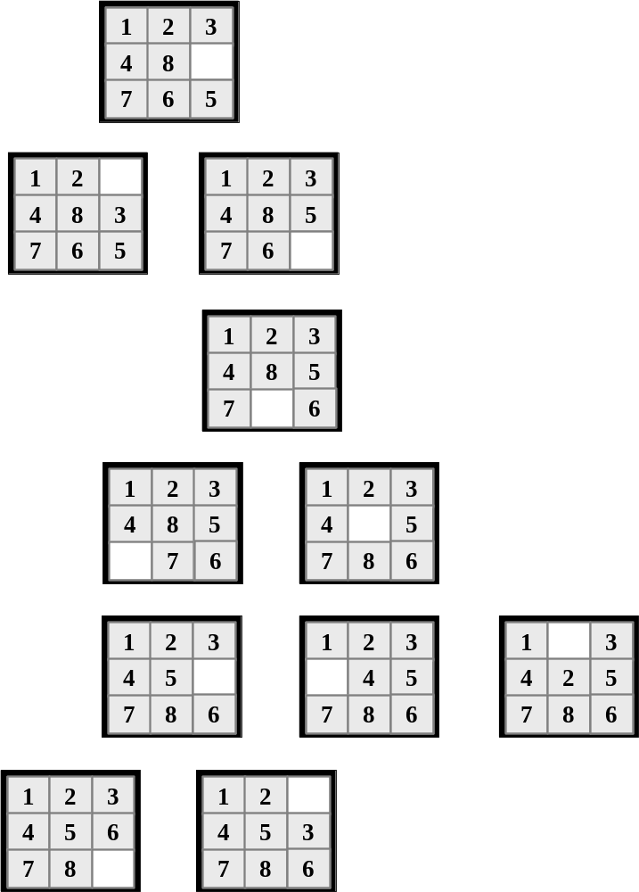
Hill climbing example(2)
h(n)
5
Heuristic : Manhattan Distance
6
4
3
4
2
1
3
3
0
2

Slide 28
Hill climbing does not work every time
h(n)
1
2
3
4
5
8
6
7
6
1
2
3
1
2
3
4
5
8
4
5
6
7
6
7
8
7
5
1
2
3
1
2
4
5
4
5
3
6
7
8
6
7
8
6
6
Problem : Local Maxima
Solution: Backtracking
Note : this puzzle is solvable in just 12 more steps.

Slide 29
Interesting Comparison
Uniform Cost
Measures the cost to each node.
Is optimal and complete!
Can be very slow.
Hill Climbing
Estimates how far away the goal is.
Is neither optimal nor complete.
Can be very fast.
Can we combine them to create an optimal and complete algorithm that is also very fast?

Slide 30
Uniform Cost Search
Enqueue nodes in order of cost
5
2
5
2
5
2
1
7
1
7
4
5
Intuition: Expand the cheapest node. Where the cost is the path cost g(n)
Hill Climbing Search
Enqueue nodes in order of estimated distance to goal
17
19
17
19
17
19
16
14
16
14
13
15
Intuition: Expand the node you think is nearest to goal. Where the estimate of distance to goal is h(n)

Slide 31
What’s the Issue?
Search is an iterative local procedure
Good heuristics should provide some global look-ahead (at low computational cost)

Slide 32
Drawbacks of hill climbing
Problems:
  Local Maxima: peaks that aren’t the highest point in the space
  Plateaus: the space has a broad flat region that gives the search algorithm no direction (random walk)
  Ridges: flat like a plateau, but with dropoffs to the sides; steps to the North, East, South and West may go down, but a step to the NW may go up.
Remedy:
  Introduce randomness
    Random restart.
Some problem spaces are great for hill climbing and others are terrible.

Slide 33

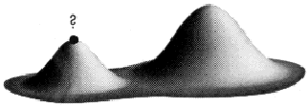
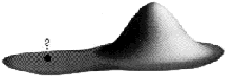
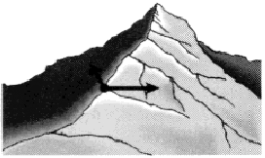
: Hill-climbing
This simple policy has three well-known drawbacks:
1. Local Maxima: a local maximum
as opposed to global maximum.
2. Plateaus: An area of the search
space where evaluation function is
flat, thus requiring random walk.
3. Ridge: Where there are steep
slopes and the search direction is
not towards the top but towards the
side.
(a)
(b)
(c)
Figure 5.9 Local maxima, Plateaus and
ridge situation for Hill Climbing

Slide 34
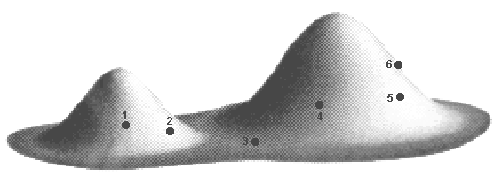
Hill-climbing
In each of the previous cases (local maxima, plateaus & ridge), the algorithm reaches a point at which no progress is being made.
A solution is to do a random-restart hill-climbing - where random initial states are generated, running each until it halts or makes no discernible progress. The best result is then chosen.
Figure 5.10 Random-restart hill-climbing (6 initial values) for 5.9(a)

Slide 35
Steepest-Ascent Hill Climbing
This is a variation of simple hill climbing which considers all the moves from the current state and selects the best one as the next state.
Also known as Gradient search

Slide 36
Algorithm: Steepest-Ascent Hill Climbing
Evaluate the initial state.
  If it is also a goal state, then return it and quit. Otherwise, continue with the initial state as the current state.
Loop until a solution is found or until a complete iteration produces no change to current state:
  Let SUCC be a state such that any possible successor of the current state will be better than SUCC
  For each operator that applies to the current state do:
    Apply the operator and generate a new state
    Evaluate the new state. If is is a goal state, then return it and quit. If not, compare it to SUCC. If it is better, then set SUCC to this state. If it is not better, leave SUCC alone.
  If the SUCC is better than the current state, then set current state to SUCC,

Slide 37
BFS and Steepest ascent hill climbing
At each step of the BFS search process, we select the most promising of the nodes we have generated so far using appropriate heuristic function and then expand the chosen node by using the rules to generate its successors
BFS is Similar to Steepest ascent hill climbing with two exceptions:
  In hill climbing, one move is selected and all the others are rejected, never to be reconsidered. This produces the straight-line behavior that is characteristic of hill climbing.
  In BFS, one move is selected, but the others are kept around so that they can be revisited later if the selected path becomes less promising. Further, the best available state is selected in the BFS, even if that state has a value that is lower than the value of the state that was just explored. This contrasts with hill climbing, which will stop if there are no successor states with better values than the current state.

Slide 38
Robot Navigation

Slide 39
Robot Navigation
f(N) = h(N), with h(N) = Manhattan distance to the goal
8
7
6
5
4
3
2
3
4
5
6
7
5
4
3
5
6
3
2
1
0
1
2
4
7
6
5
8
7
6
5
4
3
2
3
4
5
6

Slide 40
Robot Navigation
f(N) = h(N), with h(N) = Manhattan distance to the goal
8
7
6
5
4
3
2
3
4
5
6
7
5
4
3
5
6
3
2
1
0
0
1
2
4
7
What happened???
7
6
5
8
7
6
5
4
3
2
3
4
5
6

Slide 41
Greedy Search
f(N) = h(N) → greedy best-first

Slide 42
Greedy Search
f(N) = h(N) → greedy best-first
Is it complete?
  If we eliminate endless loops, yes
Is it optimal?

Slide 43
More informed search
We kept looking at nodes closer and closer to the goal, but were accumulating costs as we got further from the initial state
Our goal is not to minimize the distance from the current head of our path to the goal, we want to minimize the overall length of the path to the goal!
Let g(N) be the cost of the best
path found so far between the initial
node and N
f(N) = g(N) + h(N)

Slide 44
Robot Navigation
f(N) = g(N)+h(N), with h(N) = Manhattan distance to goal
8+3
8+3
7+4
7+4
6+5
6+3
5+6
5+6
4+7
4+7
3+8
3+8
2+9
8
7
6
5
4
3
2+9
3+10
2
3
4
5
6
7+2
7+2
5+6
4+7
3+8
7
5
4
3+8
3
5
6+1
2+9
6+1
2+9
1+10
6
3
2
1+10
0+11
1
0
1
2
4
7+0
7+0
6+1
7
6+1
6
5
8+1
8+1
7+2
7+2
6+3
6+3
5+4
5+4
4+5
4+5
3+6
3+6
2+7
8
7
6
5
4
3
2+7
3+8
2
3
4
5
6

Slide 45
Can we Prove Anything?
If the state space is finite and we avoid repeated states, the search is complete, but in general is not optimal
If the state space is finite and we do not avoid repeated states, the search is in general not complete
If the state space is infinite, the search is in general not complete

Slide 46
Admissible heuristic
Let h*(N) be the true cost of the optimal path from N to a goal node
Heuristic h(N) is admissible if:
0 ≤ h(N) ≤ h*(N)
An admissible heuristic is always optimistic

Slide 47
A* Search
Evaluation function:
f(N) = g(N) + h(N)
where:
  g(N) is the cost of the best path found so far to N
  h(N) is an admissible heuristic
Then, best-first search with this evaluation function is called A* search
Important AI algorithm developed by Fikes and Nilsson in early 70s. Originally used in Shakey robot.

Slide 48
A* Algorithm
BFS is a simplification of A* Algorithm
Presented by Hart et al
Algorithm uses:
  f’: Heuristic function that estimates the merits of each node we generate. This is sum of two components, g and h’ and f’ represents an estimate of the cost of getting from the initial state to a goal state along with the path that generated the current node.
  g : The function g is a measure of the cost of getting from initial state to the current node.
  h’ : The function h’ is an estimate of the additional cost of getting from the current node to a goal state.
  OPEN
  CLOSED

Slide 49
A* Algorithm
Start with OPEN containing only initial node. Set that node’s g value to 0, its h’ value to whatever it is, and its f’ value to h’+0 or h’. Set CLOSED to empty list.
Until a goal node is found, repeat the following procedure: If there are no nodes on OPEN, report failure. Otherwise picj the node on OPEN with the lowest f’ value. Call it BESTNODE. Remove it from OPEN. Place it in CLOSED. See if the BESTNODE is a goal state. If so exit and report a solution. Otherwise, generate the successors of BESTNODE but do not set the BESTNODE to point to them yet.

Slide 50
A* Algorithm ( contd)
For each of the SUCCESSOR, do the following:
Set SUCCESSOR to point back to BESTNODE. These backwards links will make it possible to recover the path once a solution is found.
Compute g(SUCCESSOR) = g(BESTNODE) + the cost of getting from BESTNODE to SUCCESSOR
See if SUCCESSOR is the same as any node on OPEN. If so call the node OLD.
If SUCCESSOR was not on OPEN, see if it is on CLOSED. If so, call the node on CLOSED OLD and add OLD to the list of BESTNODE’s successors.
If SUCCESSOR was not already on either OPEN or CLOSED, then put it on OPEN and add it to the list of BESTNODE’s successors. Compute f’(SUCCESSOR) = g(SUCCESSOR) + h’(SUCCESSOR)

Slide 51
Observations about A*
Role of g function: This lets us choose which node to expand next on the basis of not only of how good the node itself looks, but also on the basis of how good the path to the node was.
h’, the distance of a node to the goal.If h’ is a perfect estimator of h, then A* will converge immediately to the goal with no search.

Slide 52
How fast is A*?
A* is the fastest search algorithm. That is, for any given heuristic, no algorithm can expand fewer nodes than A*.
How fast is it? Depends of the quality of the heuristic.
If the heuristic is useless (ie h(n) is hardcoded to equal 0 ), the algorithm degenerates to uniform cost.
If the heuristic is perfect, there is no real search, we just march down the tree to the goal.
Generally we are somewhere in between the two situations above. The time taken depends on the quality of the heuristic.

Slide 53
Completeness & Optimality of A*
Claim 1: If there is a path from the initial to a goal node, A* (with no removal of repeated states) terminates by finding the best path, hence is:
  complete
  optimal
requirements:
  0 < ε ≤ c(N,N’)
  Each node has a finite number of successors

Slide 54
Completeness of A*
Theorem: If there is a finite path from the initial state to a goal node, A* will find it.
Proof of Completeness :
  Let g be the cost of a best path to a goal node
  No path in search tree can get longer than g/ε, before the goal node is expanded

Slide 55
Optimality of A*
Theorem: If h(n) is admissable, then A* is optimal.
Cost of best path
to a goal thru N
f(G1) = g(G1)
f(N) = g(N) + h(N) ≤ g(N) + h*(N)
N
G1
G2
f(G1) ≤ g(N) + h(N) ≤ g(N) + h*(N)

Slide 56
Example of Evaluation Function
f(N) = (sum of distances of each tile to its goal)
+ 3 x (sum of score functions for each tile)
where score function for a non-central tile is 2 if it is not followed by the correct tile in clockwise order and 0 otherwise
5
8
1
2
3
f(N) = 2 + 3 + 0 + 1 + 3 + 0 + 3 + 1
3x(2 + 2 + 2 + 2 + 2 + 0 + 2)
= 49
4
2
1
4
5
6
7
3
6
7
8
N
goal

Slide 57
8-Puzzle
5
8
1
2
3
4
2
1
4
5
6
7
3
6
7
8
N
goal
h1(N) = number of misplaced tiles = 6 is admissible
h2(N) = sum of distances of each tile to goal = 13
is admissible

Slide 58
8-Puzzle
f(N) = h(N) = number of misplaced tiles
3
3
4
5
3
4
2
4
2
1
3
3
0
4
5
4

Slide 59
8-Puzzle
f(N) = h(N) = Σ distances of tiles to goal
6
5
2
5
2
1
4
3
0
4
6
5

Slide 60
8-Puzzle
f(N) = g(N) + h(N)
with h(N) = number of misplaced tiles
3+3
1+5
2+3
3+4
5+2
0+4
3+2
4+1
1+3
2+3
5+0
3+4
1+5
2+4

Slide 61
Avoiding Repeated States in A*
If the heuristic h is consistent, then:
Let CLOSED be the list of states associated with expanded nodes
When a new node N is generated:
  If its state is in CLOSED, then discard N
  If it has the same state as another node in the fringe, then discard the node with the largest f

Slide 62
Complexity of Consistent A*
Let s be the size of the state space
Let r be the maximal number of states that can be attained in one step from any state
Assume that the time needed to test if a state is in CLOSED is O(1)
The time complexity of A* is O(s r log s)

Slide 63
Heuristic Accuracy
h(N) = 0 for all nodes is admissible and consistent. Hence, breadth-first and uniform-cost are particular A* !!!
Let h1 and h2 be two admissible and consistent heuristics such that for all nodes N: h1(N) ≤ h2(N).
Then, every node expanded by A* using h2 is also expanded by A* using h1.
h2 is more informed than h1

Slide 64
Iterative Deepening A* (IDA*)
Use f(N) = g(N) + h(N) with admissible and consistent h
Each iteration is depth-first with cutoff on the value of f of expanded nodes

Slide 65
8-Puzzle
f(N) = g(N) + h(N)
with h(N) = number of misplaced tiles
4
Cutoff=4
6

Slide 66
8-Puzzle
f(N) = g(N) + h(N)
with h(N) = number of misplaced tiles
4
Cutoff=4
4
6
6

Slide 67
8-Puzzle
f(N) = g(N) + h(N)
with h(N) = number of misplaced tiles
4
Cutoff=4
4
5
6
6

Slide 68
8-Puzzle
f(N) = g(N) + h(N)
with h(N) = number of misplaced tiles
5
4
Cutoff=4
4
5
6
6

Slide 69
8-Puzzle
f(N) = g(N) + h(N)
with h(N) = number of misplaced tiles
6
5
4
Cutoff=4
4
5
6
6

Slide 70
8-Puzzle
f(N) = g(N) + h(N)
with h(N) = number of misplaced tiles
4
Cutoff=5
6

Slide 71
8-Puzzle
f(N) = g(N) + h(N)
with h(N) = number of misplaced tiles
4
Cutoff=5
4
6
6

Slide 72
8-Puzzle
f(N) = g(N) + h(N)
with h(N) = number of misplaced tiles
4
Cutoff=5
4
5
6
6

Slide 73
8-Puzzle
f(N) = g(N) + h(N)
with h(N) = number of misplaced tiles
4
Cutoff=5
4
5
7
6
6

Slide 74
8-Puzzle
f(N) = g(N) + h(N)
with h(N) = number of misplaced tiles
4
5
Cutoff=5
4
5
7
6
6

Slide 75
8-Puzzle
f(N) = g(N) + h(N)
with h(N) = number of misplaced tiles
4
5
5
Cutoff=5
4
5
7
6
6

Slide 76
8-Puzzle
f(N) = g(N) + h(N)
with h(N) = number of misplaced tiles
4
5
5
Cutoff=5
4
5
7
6
6

Slide 77
Iterative Deepening A* (IDA*) Search
Just as iterative deepening solved the space problem of breadth-first search, iterative deepening A* (IDA*) eliminates the memory constraints of A* search algorithm without sacrificing solution optimality. Each iteration of the algorithm is a depth-first search that keeps track of the cost, f(n) = g(n) + h(n), of each node generated. As soon as a node is generated whose cost exceeds a threshold for that iteration, its path is cut off, and the search backtracks before continuing. The cost threshold is initialized to the heuristic estimate of the initial state, and in each successive iteration is increased to the total cost of the lowest-cost node that was pruned during the previous iteration. The algorithm terminates when a goal state is reached whose total cost dees not exceed the current threshold.
Since Iterative Deepening A* performs a series of depth-first searches, its memory requirement is linear with respect to the maximum search depth. In addition, if the heuristic function is admissible, IDA* finds an optimal solution. Finally, by an argument similar to that presented for DFID, IDA* expands the same number of nodes, asymptotically, as A* on a tree, provided that the number of nodes, asymptotically, as A* on a tree, provided that the number of nodes grows exponentially with solution cost. These costs, together with the optimality of A*, impy that IDA* is asymptotically optimal in time and space over all heuristic search algorithms that find optimal solutions on a tree. Additional benefits of IDA* are that it is much easier to implement, and often runs faster than A*, since it does not incur the overhead of managing the open and closed lists.

Slide 78
Depth-First Branch-And-Bound Search
For many problems, the maximum search depth is known in advance or the search is finite. For example, consider the traveling salesman problem (TSP) of visiting each of the given set of cities and returning to the starting city in a tour of shortest total distance. The most natural problem space for this problem consists of a tree where the root node represents the starting city, the nodes at level one represent all the cities that could be visited first, the nodes at level two represent all the cities that could be visited second, etc. In this tree, the maximum depth is the number of cities, and all candidate solution occurs at this depth. In such a space, a simple depth-first search gurantees finding an optional solution using space that is only linear with repsect to the number of cities.
The idea of depth-first branch-and-bound (DFBnB) Search is to make this search more efficient by keeping track of the lowest-cost solution found so far. Since the cost of a partial tour is the sum of the costs of the edges traveled so far, whenever a partial tour is found whose cost equals or exceeds the cost of the best complete tour found so far, the branch representing the partial tour can be pruned, since all its descendents must have equal or greater cost. Whenever a low-cost complete tour is found, the cost of the best tour is updated to this low cost. In addition, an admissible heuristic function such as the cost of the minimum spanning tree of the remaining unvisited cities, can be added to the cost so far of a partial tour to increase the amount of prunin. Finally, by carefully ordering the children of a given node from smallest to largest estimated total cost, a lower-cost solution can be
found more quickly, further improving the pruning efficiency.
Interestingly, IDA* and DFBnB exhibit complementary behavior. Both are guaranteed to return an optimal solution cost, and increase in each iteration until it reaches the optimal cost. In DFBnB, the cost of the best solution found so far is always an upper bound on the optimal solution cost and decreases until it reaches the optimal cost.
While IDA* never expands any nodes whose cost exceeds the optimal cost, its overhead cosists of expanding some nodes more than once. While DFBnB never expands any node more than once its overhead consists of expanding some nodes whose cost exceed the optimal cost. For problems whose search trees are of bounded depth, or for which it is easy to construct a good solution such as the TSP, DFBnB is usually the algorithm of choice for finding an optimal solution. For problems with infinite search trees or for which it is difficult to construct a low-cost solution, such as the sliding-tile puzzles or Rubik’s Cube, IDA* is usually the best choice.

Slide 79
Heuristic Path Search Algorithm
Since the complexity of finding optimal solutions to these problems is generally exponential in practice, in order to solve significantly larger problems, the optimality requirement must be released. An early approach to this problem was the heuristic path algorithm (HPA).
Heuristic path algorithm is a best-first search algorithm, where the figure of merit of node n is f(n) = (1-w)*g(n)+w*h(n). Varying w produces a range of algorithms from uniform-cost search (w=0) through A* (w=1/2) to pure heuristic search (w=1). Increasing w beyond ½ generally decreases the amount of computation while increasing the cost of the solution generated. The trade off is often quite favorable, with small increases in solution cost yielding huge savings in computation. Moreover, it shows that the solutions found by this algorithm are guaranteed to be no more than a factor of w/(1-w) greater than optimal, but often are significantly better.

Slide 80
Recursive Best First Search
The memory limitation of the heuristic path algorithm can be overcome simply by replacing the best-first search with IDA* search using the sure weighted evaluation function, with w>=1/2.
IDA* search is no longer a best-first search since the total cost of a child can beless than that of its parent, and thus nodes are not necessarily expanded in best-first order. Recursive Best-First Search (RBFS) is an alternative algorithm. Recursive best-first search is a best-first search that runs in space that is linear with respect to the maximum search depth, regardless of the cost funtion used. Even with an admissible cost function, Recursive Best-First Search generates fewer nodes than IDA*, and is generally superior to IDA*, except for a small increase in the cost per node generation.
It works by maintaining on the recursion stack the complete path to the current node being expanded as well as all immediate siblings of nodes on that path, along with the cost of the best node in the sub-tree explored below each sibling. Whenever the cost of the current node exceeds that of some other node in the previously expanded portion of the tree, the algorithm backs up to their deepest common ancestor, and continues the search down the new path. In effect, the algorithm maintains a separate threshold for each sub-tree diverging from the current search path.

Slide 81
Gracefull Decay of Admissibility
If h’ rarely overestimates h by more than δ, then A* algorithm will rarely find a solution whose cost is more than δ greater than the cost of the optimal solution.
Under certain conditions, the A* algorithm can be shown to be optimal in that it generates the fewest nodes in the process of finding a solution to a problem.

Slide 82
Comments on Heuristic Search
Complexity Of Finding Optimal Solutions
The time complexity of a heuristic search algorithm depends on the accuracy of the heuristic function. For example, if the heuristic evaluation function is an exact estimator, then A* search algorithm runs in linear time, expanding only those nodes on an optimal solution path. Conversely, with a heuristic that returns zero everywhere, A* algorithm becomes uniform-cost search, which has exponential complexity.
In general, the time complexity of A* search and IDA* search is an exponential function of the error in the heuristic function. For example, if the heuristic has constant absolute error, meaning that it never underestimates by more than a constant amount regardless of the magnitude of the estimate, then the running time of A* is linear with respect to the solution cost. A more realistic assumption is constant relative error, which means that the error is a fixed percentage of the quantity being estimated. The base of the exponent, however, is smaller than the brute-force branching factor, reducing the asymptotic complexity and allowing larger problems to be solved. For example, using appropriate heuristic functions, IDA* can optimally solve random instance of the twenty-four puzzle and Rubik’s Cube.

